Slide 1
Team 9 Project 2 Presentation
Team Members:
Abhinav Dubey
Emily Maher
Jiaxin Wu
Ping-Hsuan Chiang
Rumeysa Maras

Slide 2


About dataset
The dataset is an airline passenger satisfaction survey
It consists details about the customer and satisfaction rating for different elements on the flight.
It has 25 Observations and 130,273 records
The target variable is customer satisfaction, and it is categorical.

Slide 3

The business problem
The airline should meet customer expectations and achieve higher quality levels.
We need to have a specific mechanism of passenger satisfaction measurement.
Prediction will be based on the type of customer and survey response for different elements of flight.
To find elements are in high correlation with the satisfaction level and if a customer is satisfied or not.

Slide 4
Exploration of the data
Variables appear important?
Type of Customer and the variables associated with rating (scale 1 to 5)
Trends or patterns identified that are relevant to the business problem?
More satisfied customers → better chances becoming loyal customers → revenue boosted → stands out in the competition
Interesting variable relationships discovered?
The more high scores a passenger rated, the greater probability he is satisfied with the an airline company
Notes:
Jiaxin & Ivy

Slide 5

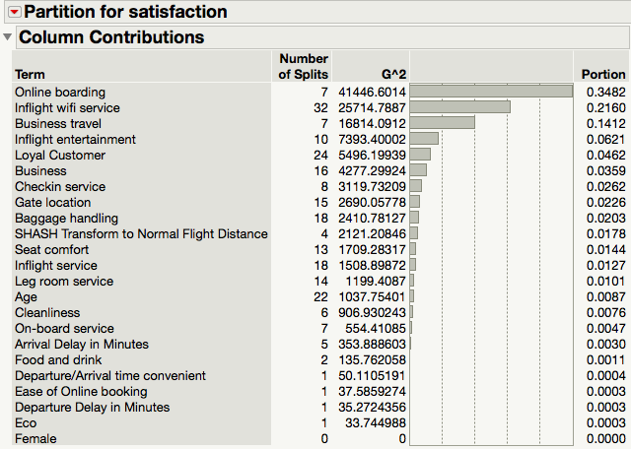
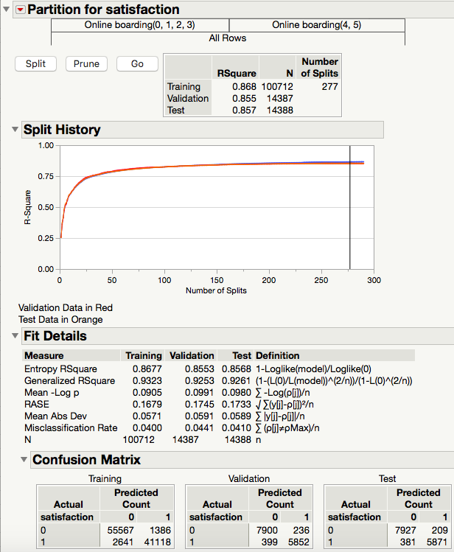
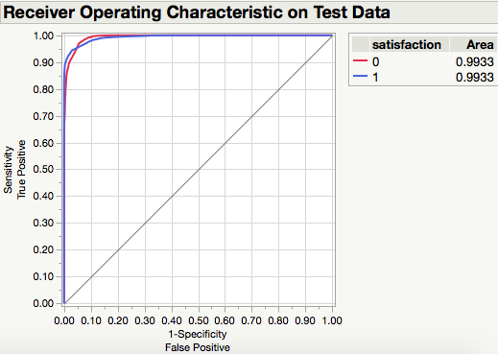
Models- Best Model
Decision Trees: accuracy=95.9%, RASE=17.3%, ROC curve=99.3% (pruned from 280 to 277 splits)
Notes:
Everyone

Slide 6
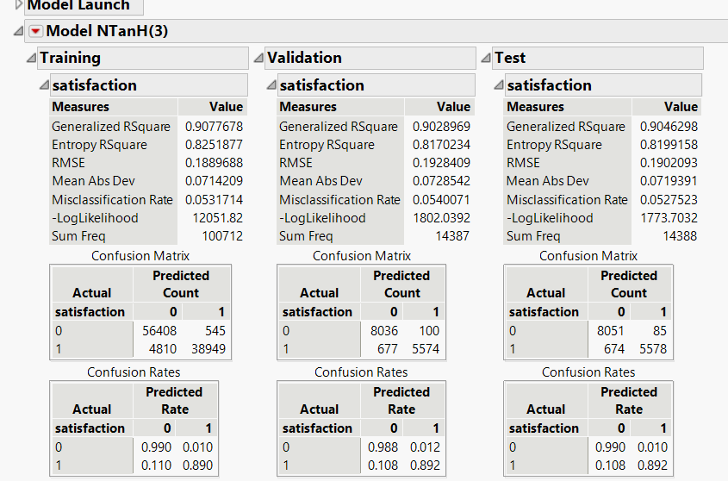
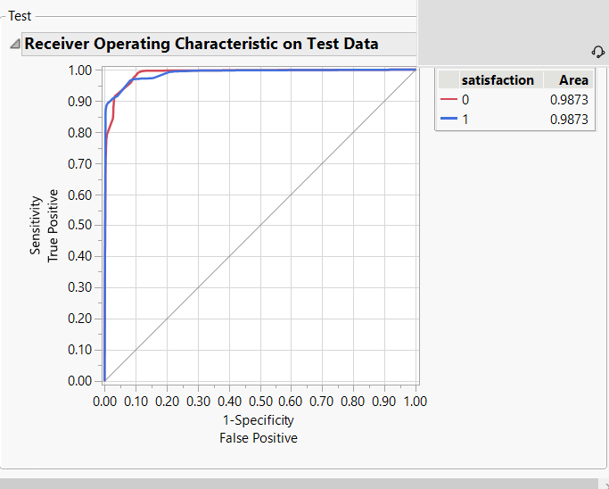
Models- Ensemble Trees and Neural Network
Ensemble Trees:
Bootstrap Forest: accuracy=91.9%, RASE=26.2%, ROC curve=96.5%
Boosted Tree: accuracy=93.8%, RASE=21.6%, ROC curve=98.4% (120 layers)
Neural Net: accuracy = 94.7%, RASE =18.9%, ROC curve= 98.7%
Random seed reset set to x= 123

Slide 7
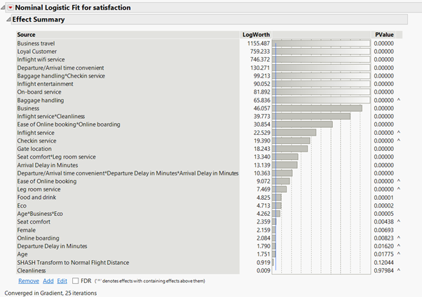
Models- Logistic Regression
Logistic regression: accuracy = 93.7% (Test Set), RASE = 22.1%
Prune:
A: Adding “Crosses” to the original variables to reduce the error that variables with similar information bring into.
Cross:
1. Baggage handling * checkin service
2. Inflight services * cleanliness
3. Seat comfort * leg room service
B: Deleting variables with high PValues.

Slide 8
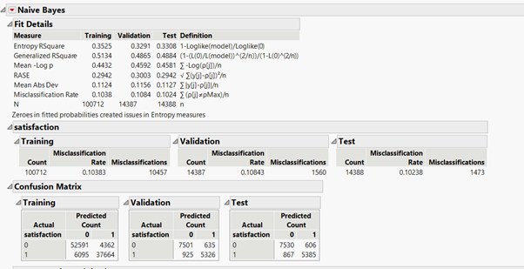
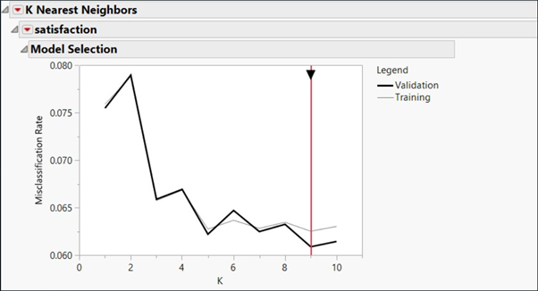
Models- Naïve Bayes and KNN
Naive Bayes: accuracy = 89.77% (Test Set), RASE = 29.42% (AUC = 94.97%)
K Nearest Neighbor (KNN): accuracy = 93.55%, K =9 (Misclassifications = 928)

Slide 9
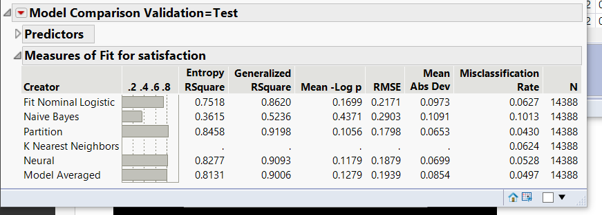
Models- Ensemble Model
Ensemble Models:
Simple Model Averaging
Model Averaging (Weighted)

Slide 10

Relevant business finding
WHAT DRIVES PASSENGER SATISFACTION?
Online Boarding
Inflight Wifi Service
Type of Travel (Business vs. Personal)
Customer Loyalty
SURPRISING INSIGHTS
The following had little impact on customer satisfaction:
Gender, Cleanliness, Travel Class, Delays in Arrival and Departure
What recommendations can be made? Insights for the company based on modelh
Notes:
Rumeysa & Emily

Slide 11

Increasing Customer Satisfaction
Provide user-friendly online boarding option to your customers
It needs to be intuitive and effective
Offer highly quality inflight Wi-Fi and entertainment service
Reliable and accessible Wi-Fi
A variety of movie genres, access to headphones
Analyze services offered those on Business Travel & Loyal Customers → these customers had much higher satisfaction rates

